Slide 1
TROUGH THE BARRIER -CREATURES-
Jordy ANDRIAMBOAVONJY
Interaction Design and Previsualisation

Slide 2

Table of contents
01
Context
02
Story board
03
Video
04
Tools

Slide 3
Context
Inspiration
Back Story
Commun factor
Harry Potter, Percy Jackson, Pan’s Labyrinth, Narnia
Men and creatures have always lived in the same world but Men can no longer see the creatures around them. Only the one who listen, would be blessed with the power to see what’s beyond the barrier…
A world only THE CHOSEN
can see

Slide 4
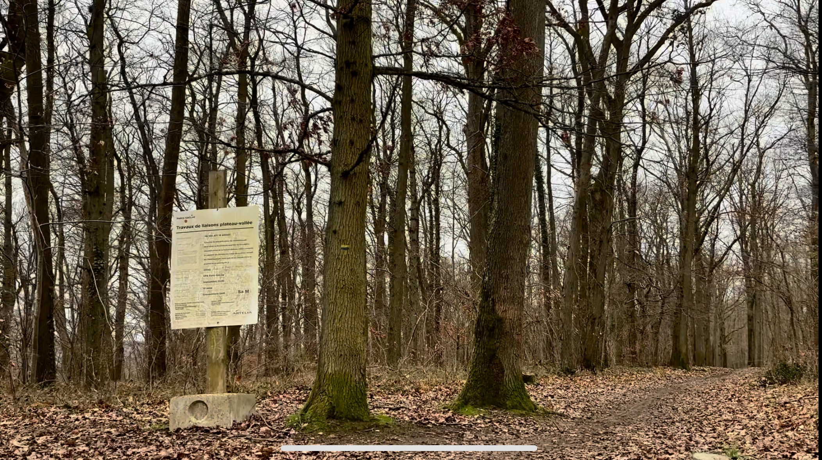
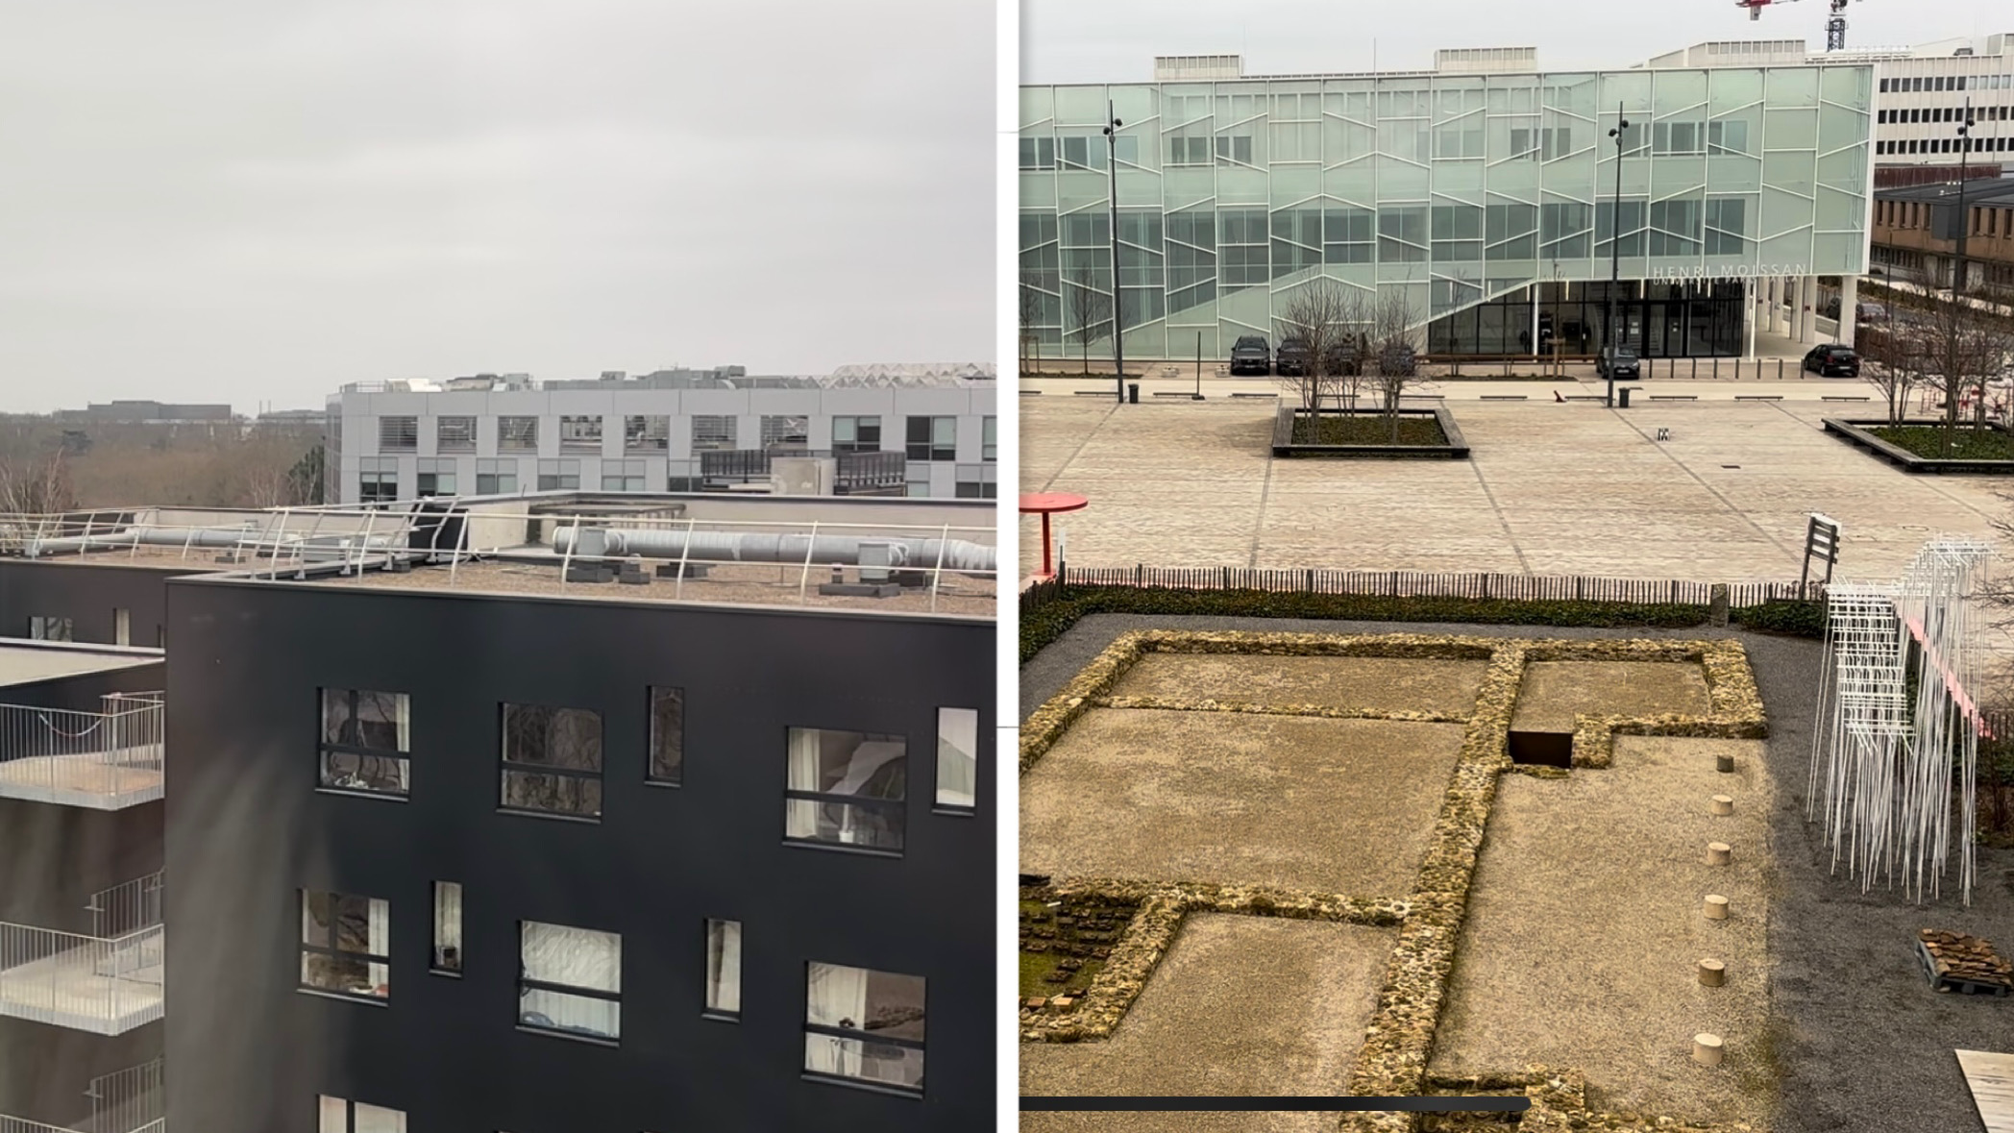
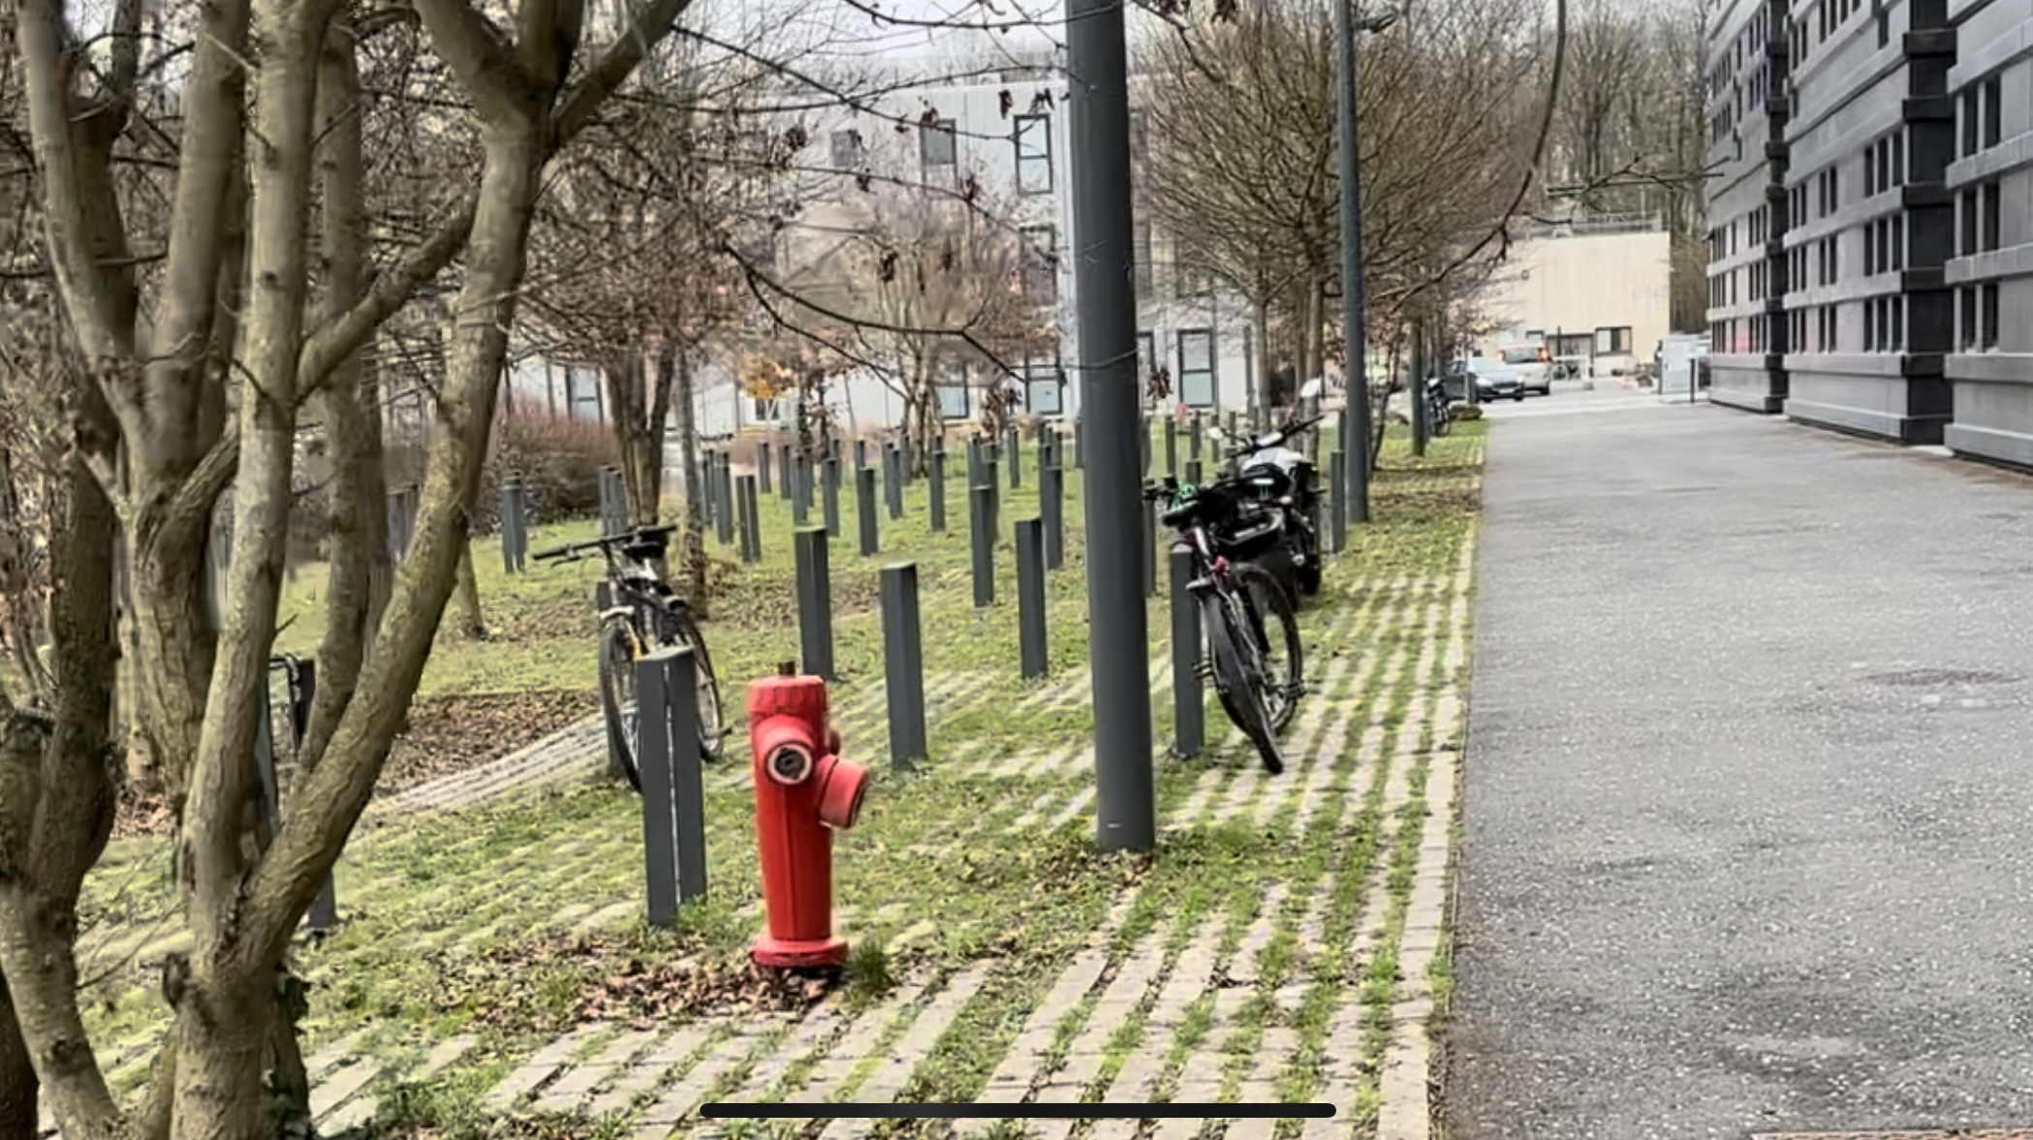
Storyboard
Final scene: human/creature interaction
Location: to be defined
Presentation/lift of the barrier.
Minotaur
01
02
03
04
Dragon / Flying
Centaur

Slide 5
Video

Slide 6
TOOLS
Software : Cinema 4D
Websites :
- TurboSquid
- Mixamo
Materials :
- Motion Tracking
- 3D Modeling
- Deformers
- Materials and Texture editing
- Motion Capture

Slide 7
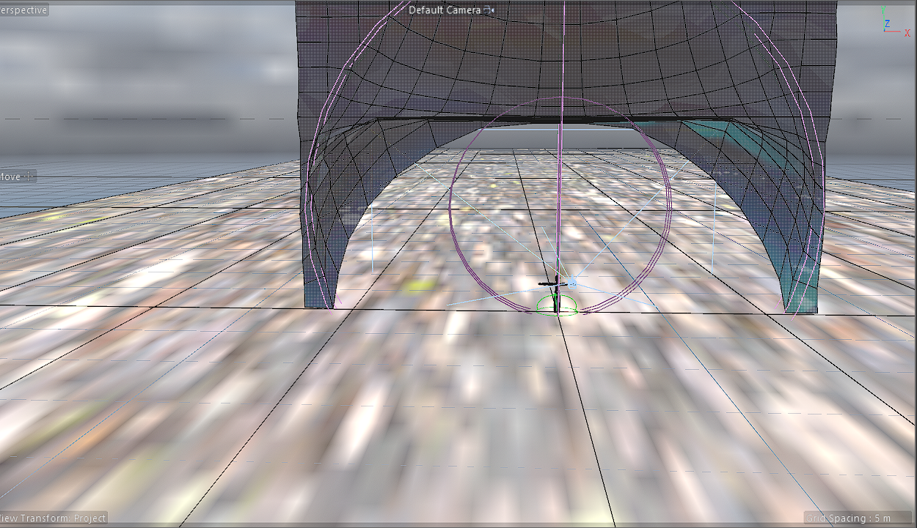
TOOLS

Slide 8
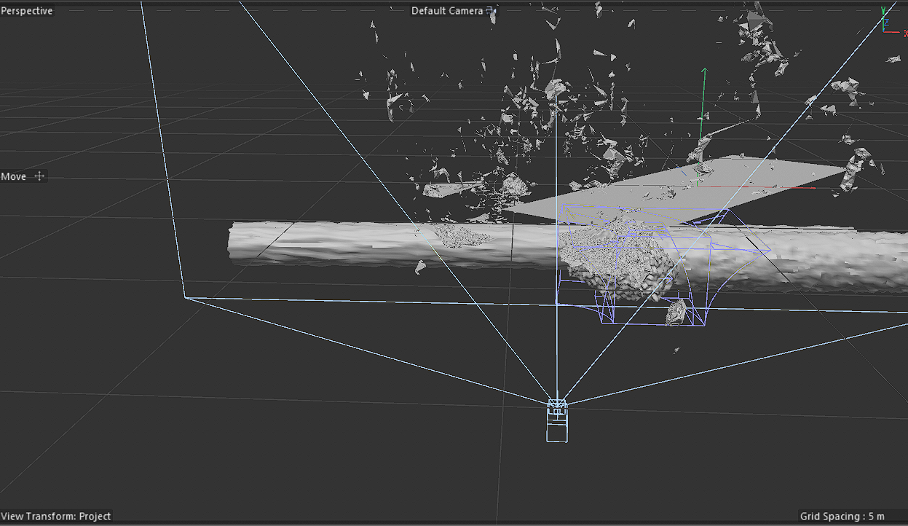
TOOLS

Slide 9
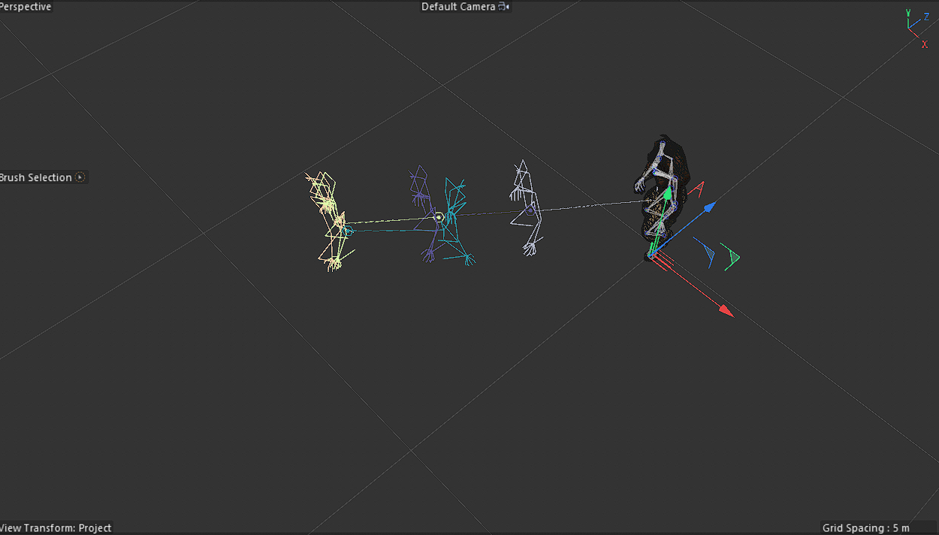
TOOLS

